Slide 1
Synchronization
Tanenbaum Chapter 6
plus additional papers

Slide 2
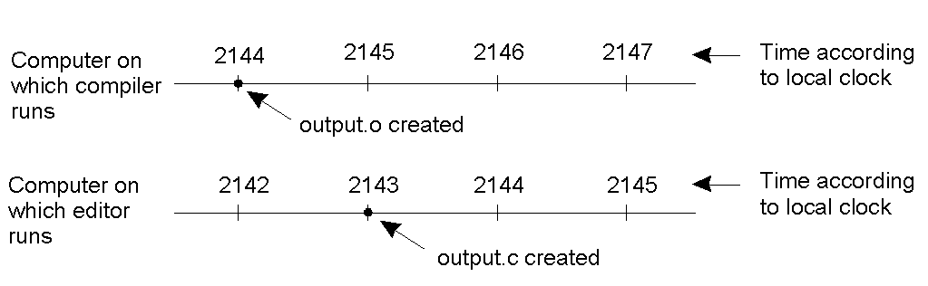
Clock Synchronization
Fig 6-1. In a distributed system, each machine has its own clock. When this is the case, an event that occurred after another event may nevertheless be assigned an earlier time.

Slide 3
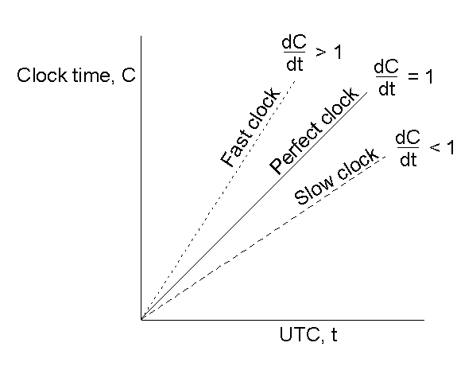
Clock Synchronization Algorithms
Fig 6-5. Even clocks on different computers that start out synchronized will typically skew over time. The relation between clock time and UTC when clocks tick at different rates.
Q: Is it possible to synchronize all clocks in a distributed system?

Slide 4
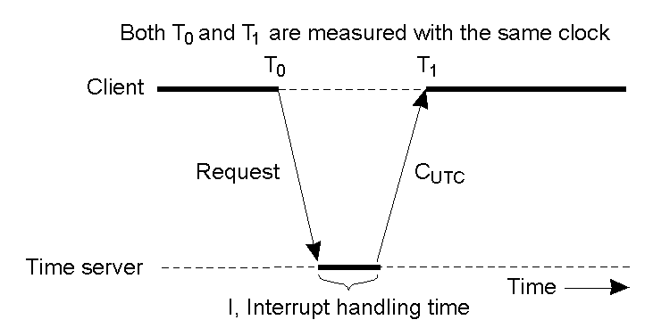
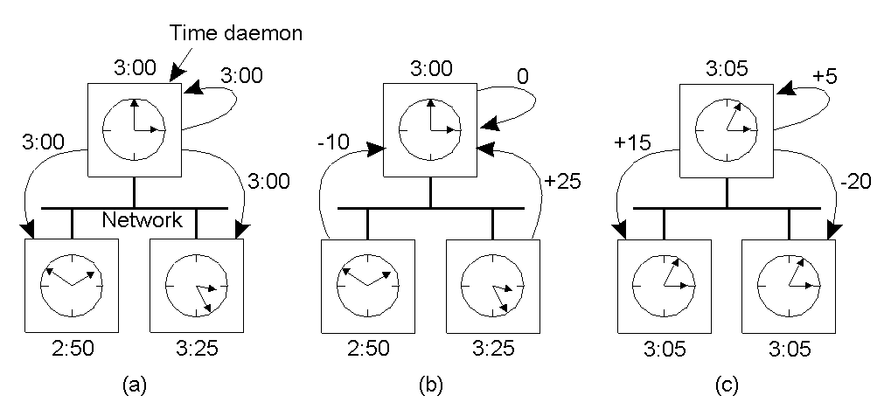
Physical Clock Synchronization
Cristian’s Algorithm and NTP – periodically get information from a time server (assumed to be accurate).
Berkeley – active time server uses polling to compute average time. Note that the goal is the have correct ‘relative’ time

Slide 5
Clock Synchronization in Wireless Networks
In wireless networking:
We can no longer assume the existence of a time server
Nodes are resource constrained (power and functionality)
Reference broadcast synchronization (RBS), used in sensor networks, takes advantage of the fact that the time to propagate a signal is roughly constant. For this reason, a sender broadcasting a message can allow the receivers to adjust their clocks.

Slide 6
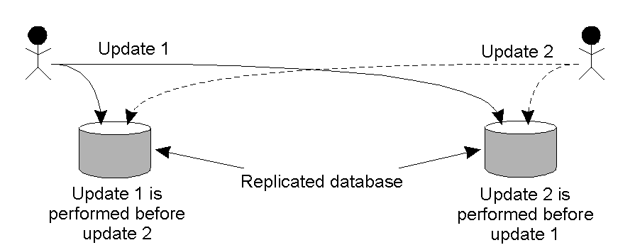
Logical Clocks
Observation: It may be sufficient that every node agrees on a current time – that time need not be ‘real’ time.
Taking this one step further, in some cases, it is adequate that two systems simply agree on the order in which system events occurred.

Slide 7
Lamport’s Logical Clocks (1)
We can define a systems as a collection of processes that communicate by exchanging messages. Each process consists of a sequence of events.
The "happens-before" relation on process events → can be observed directly in two situations:
If a and b are events in the same process, and a occurs before b, then a → b is true.
If a is the event of a message being sent by one process, and b is the event of the message being received by another process, then a → b
Two distinct events are concurrent if a → b and b → a where → means that no relative ordering exists between the processes.

Slide 8
Lamport’s Logical Clocks (2)
This → relation is transitive and can be used to define a partial ordering on the events in a distributed system. A total ordering can also be assigned assuming we can associate a process number with associated events to be used as a tie-breaker.
Now we need a way of assigning a time C(a) (for event a), where if a → b then C(a) < C(b). In addition, clock time C can only move forward.

Slide 9
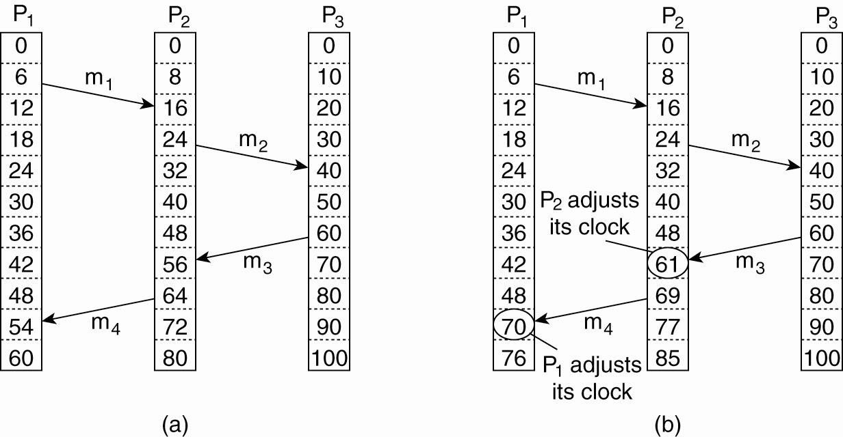
Lamport’s Logical Clocks (3)
Figure 6-9. (a) Three processes, each with its own clock. The clocks run at different rates. (b) As messages are exchanged, the logical clocks are corrected.

Slide 10
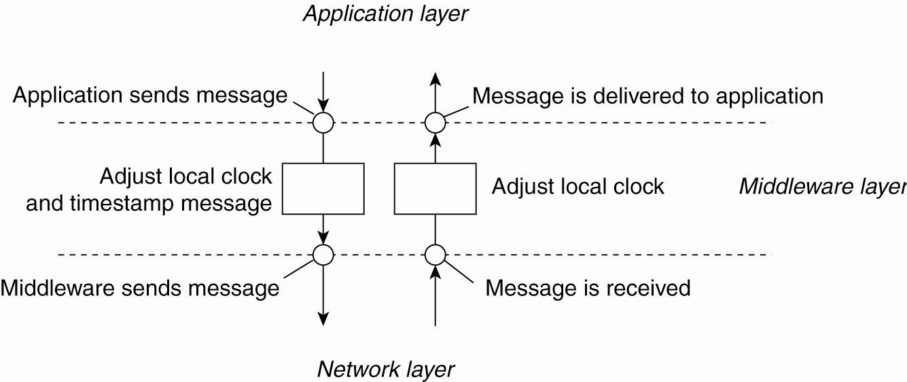
Lamport’s Logical Clocks (4)
Figure 6-10. The positioning of Lamport’s logical
clocks in distributed systems.

Slide 11
Lamport’s Logical Clocks (5)
Each process maintains a local counter C_{i}. Updating counter C_{i} for process P_{i}
Before executing an event P_{i} executes
C_{i} ← C_{i} + 1.
When process P_{i} sends a message m to P_{j}, it sets m’s timestamp ts (m) equal to C_{i} after having executed the previous step.
Upon the receipt of a message m, process P_{j} adjusts its own local counter as
C_{j} ← max{C_{j} , ts (m)}, after which it then executes the first step and delivers the message to the application.

Slide 12
Example: Totally-Ordered Multicasting
Fig 6-11. Updating a replicated database and leaving it in an inconsistent state. Need a way to ensure that the two updates are performed in the same order at each database.

Slide 13
Totally-Ordered multicast
Clock algorithm can be used to prevent this:
Assume messages from the same sender are received in order sent and no messages are lost.
Each message multicast is timestamped with the current logical time of sender. All members of the group receive a copy of any message sent, including the sender.
When a process receives a message, it puts it into a local queue ordered by timestamp. The receiver multicasts an acknowledgement to other processes (with larger timestamp).
A process can deliver a queued message with timestamp t to the application (removing it and all associated acknowledgements) when that message is at the head of the queue and it has been acknowledged by each other process with a message stamped later than time t.

Slide 14
Totally-Ordered multicast
Why does this work?
Consider the ‘failure scenario.’ In order for the updates to happen in different orders at different places, we have to have the following:
At DB 1:
Received request₁ and request₂ with timestamps 4 and 5, as well as acknowledgements from ALL processes of request₁. DB1 performs request₁.
At DB 2:
Received request₂ with timestamp 5, but not the request₁ with timestamp 4 and acknowledgements from ALL processes of request₂. DB2 performs request₂.
Why can’t this happen??

Slide 15
Distributed Mutual Exclusion
Algorithm for granting the controlled resource to a process which satisfies the following conditions:
A process which has been granted the resource must release it before it can be granted to another process.
Different requests for the resource must be granted in the order in which they are made.
If every process which is granted the resource eventually releases it, then every request is eventually granted.
Same assumptions about message ordering and lost messages.

Slide 16
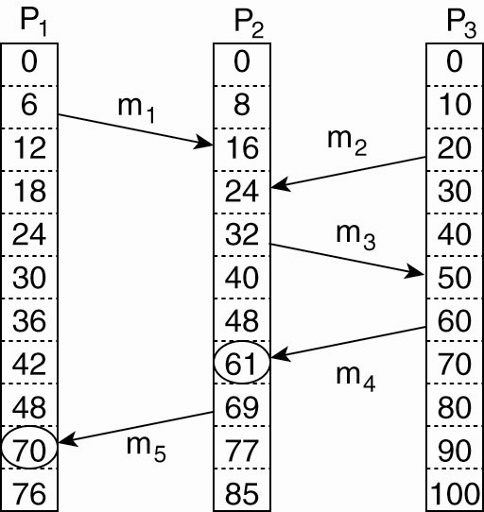
Vector Clocks (1)
Logical clocks assign a time C(a) to events; however, C(a) < C(b) does not imply that a really happened before b.
Vector clocks can capture causality; VC(a) < VC(b) means that event a causally preceeds event b.
Assume T_{snd}(m_{i}) is the logical time that message m_{i} was sent;T_{rcv} is defined similarly. Above, T_{rcv} (m₁) < T_{snd}(m₃) is probably meanful; T_{rcv} (m₁) < T_{snd}(m₂) is not.

Slide 17
Vector Clocks (2)
Vector clocks are constructed by letting each process P_{i} maintain a vector VC_{i} with the following two properties:
VC_{i} [ i ] is the number of events that have occurred so far at P_{i}. In other words, VC_{i} [ i ] is the local logical clock at process P_{i} .
If VC_{i} [ j ] = k then P_{i} knows that k events have occurred at P_{j}. It is thus P_{i}’s knowledge of the local time at P_{j} .

Slide 18
Vector Clocks (3)
Steps carried out to accomplish property 2 of previous slide:
Before executing an event P_{i} executes
VC_{i} [ i ] ← VC_{i} [i ] + 1.
When process P_{i} sends a message m to P_{j}, it sets m’s (vector) timestamp ts (m) equal to VC_{i} after having executed the previous step.
Upon the receipt of a message m, process P_{j} adjusts its own vector by setting
VC_{j} [k ] ← max{VC_{j} [k ], ts (m)[k ]} for each k, after which it executes the first step and delivers the message to the application.

Slide 19
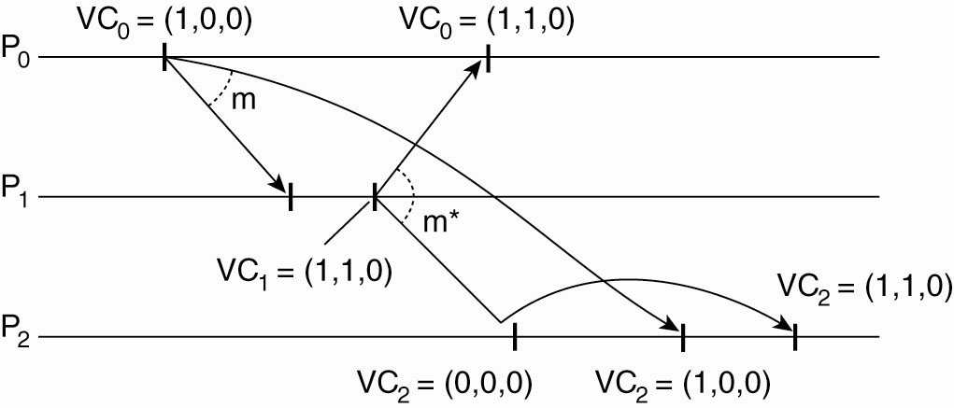
Vector Clocks (4)
First, P₀ increments its
vector from (0,0,0)
to (1,0,0)
then sends
this to P₁ and P₂
Next, P₁ receives message from P₀ and
updates its vector from (0,0,0) to (1,1,0).
This is the vector it will send to P₀ and P₂.

Slide 20
Vector Clocks: Enforcing causal communication
In P₂, incoming message from P₁
delayed because counter indicates that
P₁ has seen an event from P₀ that P₂
hasn’t seen.
When P_{j} receives a message m from P_{i} with vector timestamp ts(m), the delivery of the message is delayed until:
ts(m)[i] = VC_{j}[i] + 1 [m is the next message that Pj was expecting to get from Pi.]
ts(m)[k] <= VC_{j}[k] for all k <> i [P_{j} has seen all the messages that have been seen by P_{i} when it sent message m].

Slide 21
Global State (1)
The ability to extract and reason about the global state of a distributed application has several important applications:
distributed garbage collection
distributed deadlock detection
distributed termination detection
distributed debugging
While it is possible to examine the state of an individual process, getting a global state is problematic.
Q: Is it possible to assemble a global state from local states in the absence of a global clock?

Slide 22
Global State (2)
Consider a system S of N processes p_{i} (i = 1, 2, …, N). The local state of a process p_{i} is a sequence of events:
history(p_{i}) = h_{i} = <e_{i}⁰,e_{i}¹,e_{i}²,…>
  We can also talk about any finite prefix of the history:
h_{i}^{k} = <e_{i}⁰,e_{i}¹,…,e_{i}^{k}>
An event is either an internal action of the process or the sending or receiving of a message over a communication channel (which can be recorded as part of state). Each event influences the process’s state; starting from the initial state s_{i}⁰, we can denote the state after the k^{th} action as s_{i}^{k}.
The idea is to see if there is some way to form a global history
H = h₁ ∪ h₂ ∪ … ∪ h_{N}
This is difficult because we can’t choose just any prefixes to use to form this history.

Slide 23
Global State (3)
A cut of the system’s execution is a subset of its global history that is a union of prefixes of process histories:
C = h₁^{c1} ∪ h₂^{c2} ∪ … ∪ h_{N}^{cN}
The state s_{i} in the global state S corresponds to the cut C that is of p_{i} immediately after the last event processed by p_{i} in the cut. The set of events {e_{i}^{ci}:i = 1,2,…,N} is the frontier of the cut.
p1
e₁⁰
e₁¹
e₁²
p2
e₂⁰
e₂¹
p3
e₃⁰
e₃¹
e₃²
Frontier

Slide 24
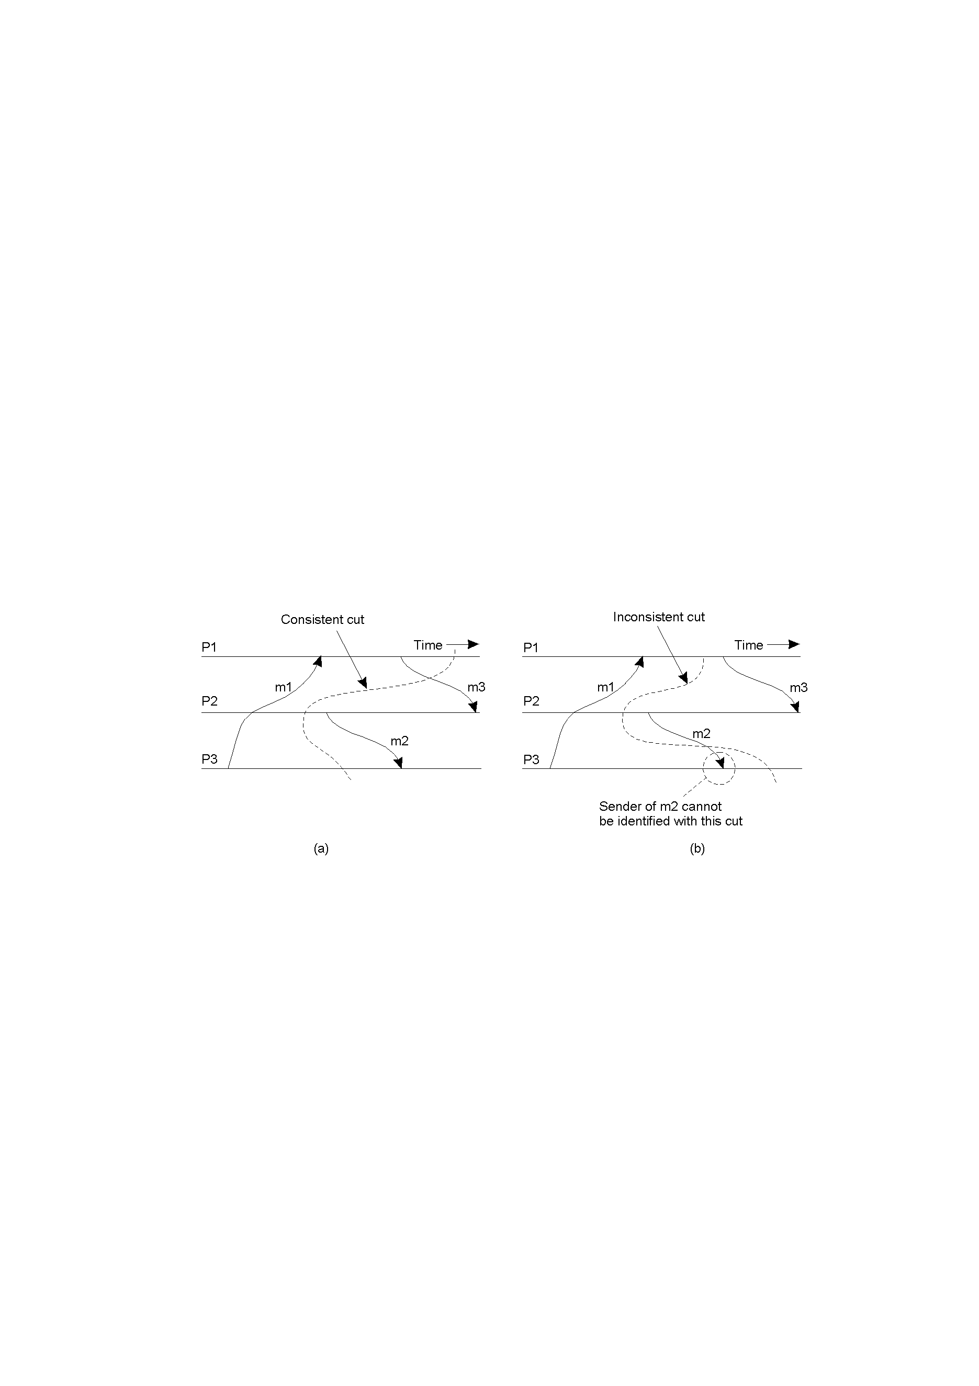
Global State (4)
A cut of a system can be inconsistent if it contains receipt of a message that hasn’t been sent (in the cut).
A cut is consistent if, for each event it contains, it also contains all the events that happened-before (→) the event:
events e ∈ C, f e ⇒ f ∈ C
A consistent global state is one that corresponds to a consistent cut.

Slide 25
Global State (5)
The goal of Chandy & Lamport’s ‘snapshot’ algorithm is to record the state of each of a set of processes such a way that, even though the combination of recorded states may never have actually occurred, the recorded global state is consisent.
Algorithm assumes that:
Neither channels or process fail and all messages are delivered exactly once
Channels are unidirectional and provide FIFO-ordered message delivery
There is a distinct channel between any two processes that communicate
Any process may initiate a global snapshot at any time
Processes may continue to execute and send and receive normal messages while the snapshot is taking place.

Slide 26
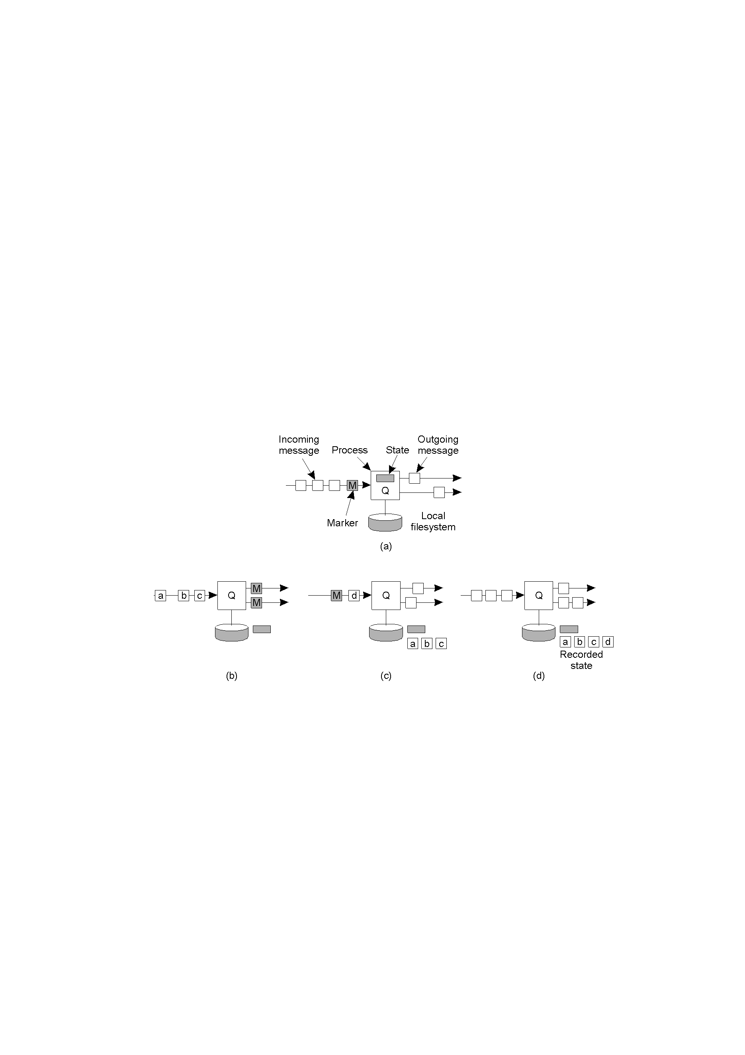
Global State (6)
Organization of a process and channels for a distributed snapshot. A special marker message is used to signal the need for a snapshot.

Slide 27
Global State (7)
Marker receiving rule for process p_{i}
  On p_{i}’s receipt of a marker message over channel c
    if (p_{i} has not yet recorded its state) it
      records its process state
      records the state of channel c as the empty set
      turns on recording of messages arriving over all incoming channels
    else
      p_{i} records the state of c as the set of messages it has received over c since it saved its state
    end if
Marker sending rule for process p_{i}
  After p_{i} has recorded its state, for each outgoing channel c:
    p_{i} sends one marker message over c (before it sends any other message over c)

Slide 28
Global State (8)
Process Q receives a marker for the first time and records its local state. It then sends a marker on all of its outgoing channels.
Q records all incoming messages
Once Q receives another marker for all its incoming channels and finishes recording the state of the incoming channel

Slide 29
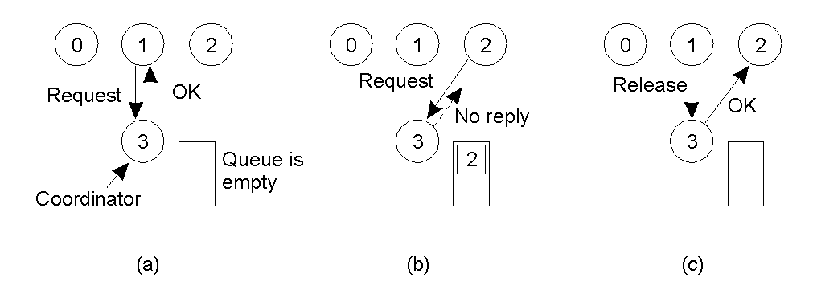
Mutual Exclusion:
A Centralized Algorithm
Process 1 asks the coordinator for permission to enter a critical region. Permission is granted
Process 2 then asks permission to enter the same critical region. The coordinator does not reply.
When process 1 exits the critical region, it tells the coordinator, when then replies to 2

Slide 30
Distributed Mutual Exclusion: Lamport clocks [1978]
To request the resource at time T, process P sends the message T:P requests resource to every other process and puts that message on its request queue.
When process R receives the message T:P requests resource, it places the message on its request queue and sends a timestamped acknowledgement message to process P.
To release the resource, process P removes a T:P requests resource message from its request queue and sends a timestamped P releases resource message to every other process.
When process R receives a P releases resource message, it removes any T:P requests resource messages from its request queue.
Process P is granted the resource when the following two conditions are satisfied, (i) There is a T:P requests resource message in its request queue which is ordered before any other request. (ii) Process P has received a message from every other process timestamped later than T.
Assume that the resource is initially granted to exactly one process.
Note that the failure of a single process makes it impossible for any other process to continue.

Slide 31
Distributed Mutual Exclusion: Ricart/Agrawala[1981]
When a process wants to access the resource, it sends a timestamped request message to all other processes and waits for an OK from all processes. When a process receives a request, it does one of three things:
If the receiver not accessing the resource and does not want to access it, it sends an OK back to sender
If the receiver already has access to the resource, it simply does not reply and the request is queued.
If the receiver wants to access the resource as well but has not yet done so, it compares the request timestamp with the one it sent and the lowest wins (meaning it will do either 1 or 2 above).
Assumes that events are totally ordered and that message sending is reliable.
Requires fewer messages than the Lamport version
Problems:
if any process fails, things stop working (can use majority vote)
requires a process to know about all other processes (unlike the centralized version)

Slide 32
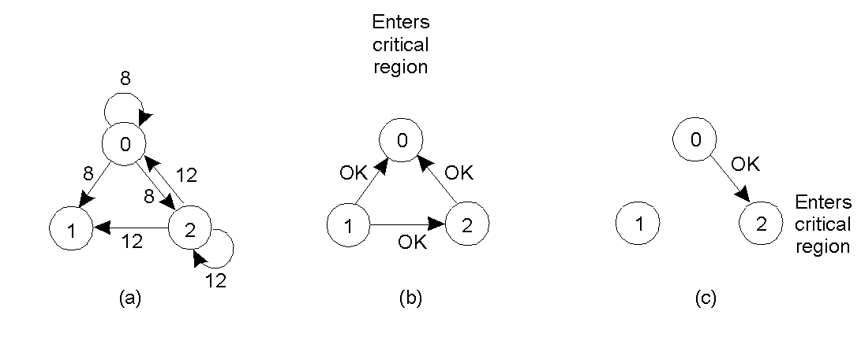
Distributed Mutual Exclusion: Ricart/Agrawala[1981]
Two processes want to enter the same critical region at the same moment.
Process 0 has the lowest timestamp, so it wins.
When process 0 is done, it sends an OK also, so 2 can now enter the critical region.

Slide 33
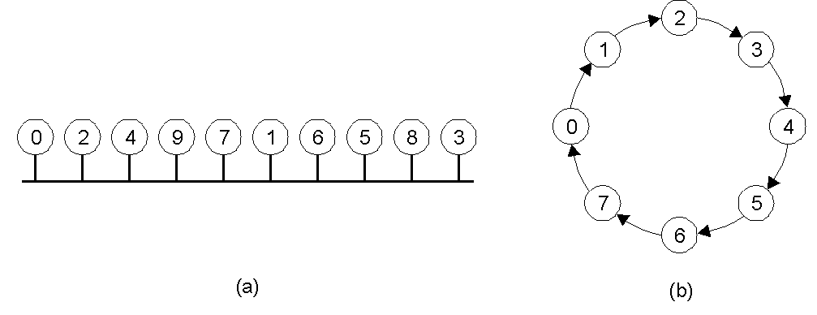
Distributed Mutual Exclusion: Token Rings
An unordered group of processes on a network.
A logical ring constructed in software.
Algorithm works by passing a token around the ring. When a process holds the token, it decides if it needs to access the resource at this time. If so, it holds the token while it does so, passing the token on once done.
Problems if the token is ever ‘lost’ – token loss may also be difficult to detect.

Slide 34
Comparison
Algorithm | Messages per entry/exit | Delay before entry (in message times) | Problems
Centralized | 3 | 2 | Coordinator crash
Distributed (Ricart/Agrawala) | 2 ( n – 1 ) | 2 ( n – 1 ) | Crash of any process
Token ring | 1 to ∞ | 0 to n – 1 | Lost token, process crash
A comparison of three mutual exclusion algorithms.

Slide 35
Election Algorithms
Some algorithms require some participating process to act as coordinator. Assuming
  all processes are the same except for a unique number
  the highest numbered process gets to be coordinator
  processes can fail and restart
Election algorithms are a method of finding this highest numbered process and making it known to all processes as the coordinator.

Slide 36
The Bully Algorithm[1982] (1)
When process P notices that the current coordinator is no longer responding to requests, it initiates an election:
  P sends an ELECTION message to all processes with higher numbers.
  If no one responds, P wins the election and becomes coordinator.
  If one of the higher-ups answers, it takes over. P’s job is done.

Slide 37
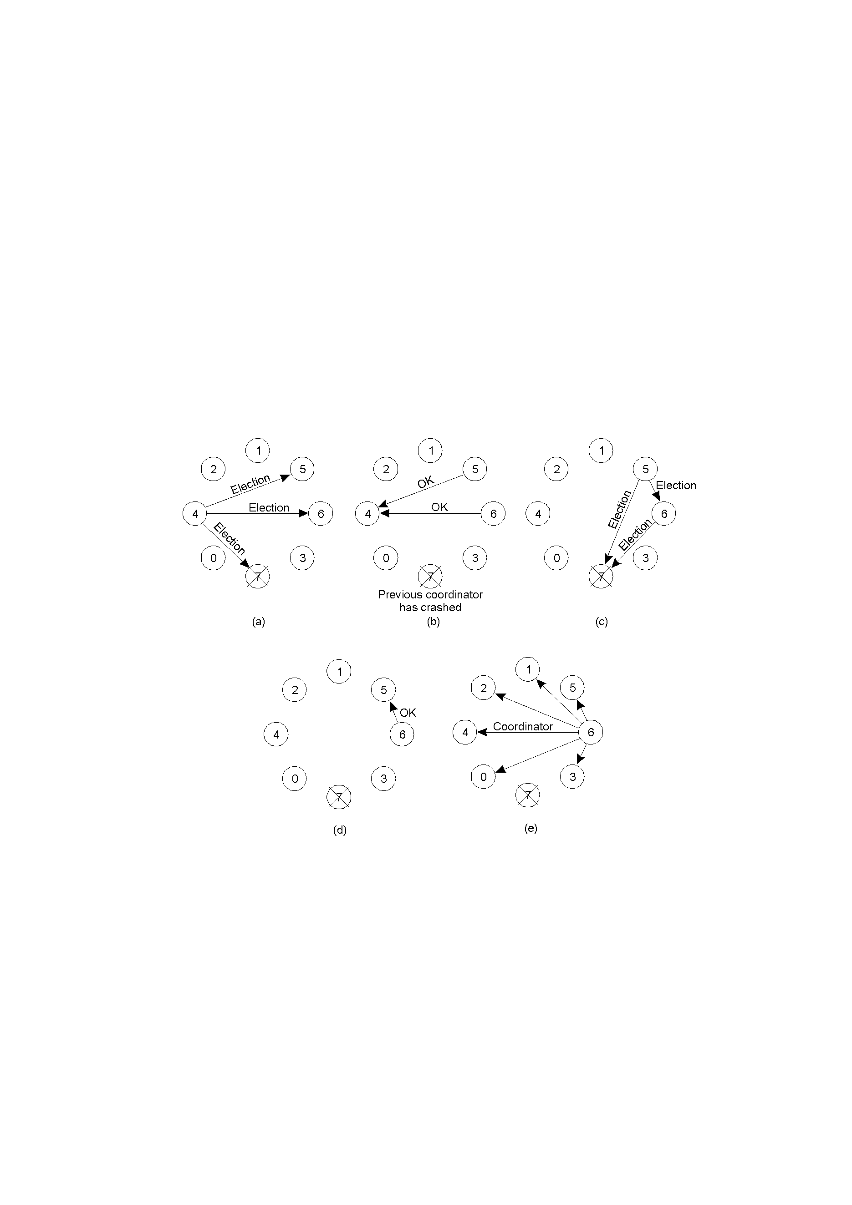
The Bully Algorithm (2)
Fig 6-20. The bully election algorithm
Process 4 notices that 7 is no longer available and holds an election by sending messages to 5 and 6
Process 5 and 6 respond, telling 4 to stop
Now 5 and 6 each hold an election

Slide 38
Bully Algorithm (3)
Process 6 tells 5 to stop
Process 6 wins and tells everyone
if process 7 ever restarts, it will notify everyone that it is the coordinator

Slide 39
A Ring Election Algorithm (1)
Assume the processes form a ring where each process talks to its successor.
When process P notices that the current coordinator is no longer responding to requests:
  P creates a ELECTION message containing its process number and sends to its successor. If the successor is not available, it tried the next process.
  When a process receives an election message, it adds its process number to the list
  When the process that started the election receives its message back (it has been around the ring), it changes the message to a coordinator message and re-circulates it, informing everyone both who the new coordinator is and what other processes are in the ring.

Slide 40
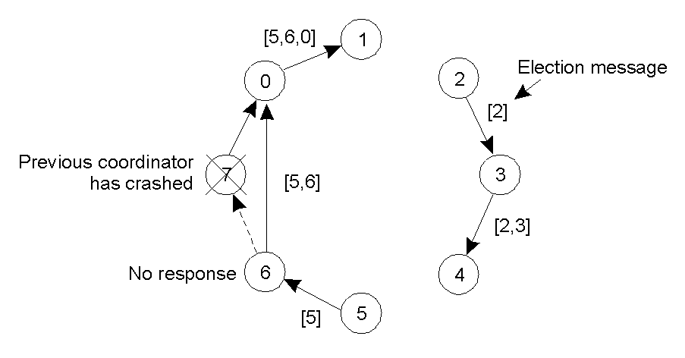
A Ring Election Algorithm (2)
Election algorithm using a ring where two different process initiate an election (5 and 2).

Slide 41
Election in Wireless environments (1)
Traditional election algorithms assume that communication is reliable and that topology does not change.
Vasudevan [2004] – elect the ‘best’ node in ad hoc networks
To elect a leader, any node in the network can initial an election by sending an ELECTION message to all nodes in range.
When a node receives an ELECTION for the first time, it chooses the sender as its parent and sends the message to all nodes in range except the parent.
When a node later receives an ELECTION message from a non-parent, it merely acknowledges the message
Once a node has received acknowledgements from all neighbors except parent, it sends an acknowledgement to the parent. This acknowledgement will contain information about the best leader candidate based on resource information of neighbors.
Eventually the node that started the election will get all this information and use it to decide on the best leader – this information can be passed back to all nodes.

Slide 42
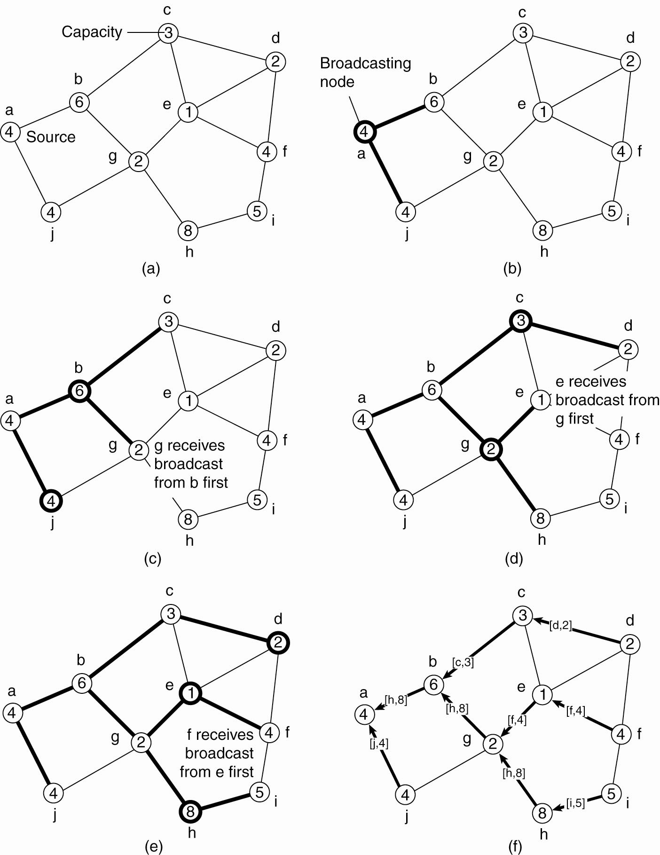
Elections in Wireless Environments (2)
Figure 6-22. Election algorithm in a wireless network, with node a as the source. (a) Initial network. (b)–(e) The build-tree phase

Slide 43
Elections in Wireless Environments (3)
Figure 6-22. Election algorithm in a wireless network, with node a as the source. (a) Initial network. (b)–(e) The build-tree phase

Slide 44
Elections in Wireless Environments (4)
Figure 6-22. (e) The build-tree phase. (f) Reporting of best node to source.

